Slide 1






Space Environment Radiation Testing
On Electrical Components
Mairely Urias, Dr. Hugh Barnaby
Arizona State Univeristy
School of Electrical, Computer, and Energy Engineering
2023 Arizona/NASA Space Grant Symposium
April 22, 2023

Slide 2


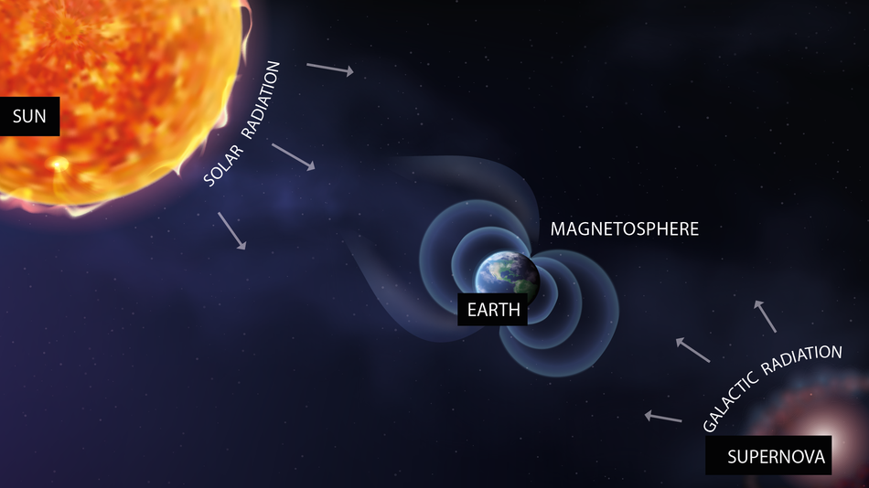

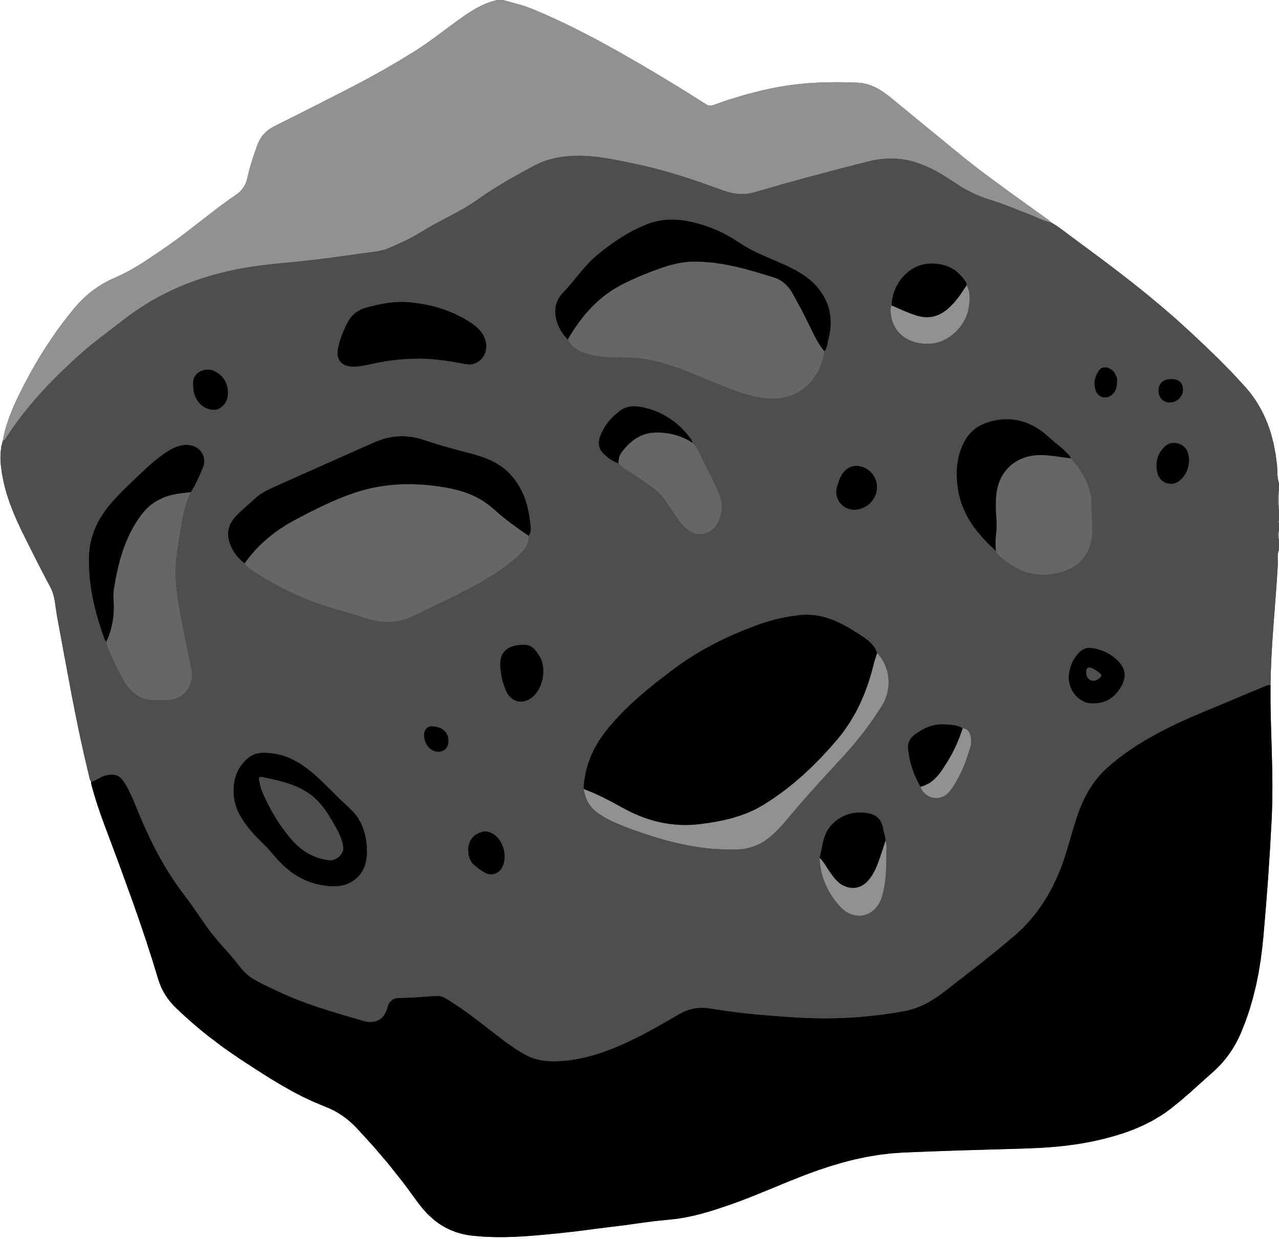
SPACE RADIATION
Radiation: Energy that is emmited in the form of rays, electromagnetic waves, and/or particles
Space Radiation: made up of atoms in which electrons have been stripped away as atoms accelerate in interstellar space to speeds approaching the speed of light, Ionizing Radiation
Sources:
Particles trapped in Earth's magnetic field
O1
O2
Solar particle events
O3
Galactic cosmic rays

Slide 3







RADIATION EFFECTS IN ELECTRONICS
Upsets/Anomalies:
  Loss of data
  Spurious signals
  Phantom commands
  Performance degradation
  Single Event Effects (SEE) in microelectronics:
    1101 0101
  Electromagnetic pulses
  Range from transient, cumulative, permanent, recoverable, or destructive
SYSTEM FAILURE

Slide 4


SINGLE EVENT EFFECTS
TOTAL IONIZING DOSE
  Individual incidents
  Single highly energetic particle
  Soft errors:
    Non-destructive, bit flips, logic transients
  Hard errors
    Permanent functional effects
    May or may not be destructive
  Latch-ups, burnouts, gate ruptures
  Cumulative, long term
  Caused by all ionizing radiation sources
  Performance degradation
  Potentially leads to failure over time
  Voltage shifts, leakage currents, gain degradation

Slide 5





ANALOG FAILURES
POWER FAILURES
  Performance Degradation
  Operational Failures
  Power Control Malfunctions
CODE/ALGORITHM FAILURES
DIGITAL FAILURES
  Memory Corruption
  Soft Errors
    1101 0101
  Code Corruption

Slide 6


RADIATION HARDENING BY DESIGN
O1
Identify failure mechanisms
GOALS
O2
Identify radiation effects responsible
  INCREASE RELIABILITY
O3
Measure radiation effects & failure mechanisms
  INCREASE LIFESPAN
O4
Use knowledge to improve design
  REDUCE/ELIMINATE SUSCEPTIBILITY TO FAILURE MECHANISMS

Slide 7
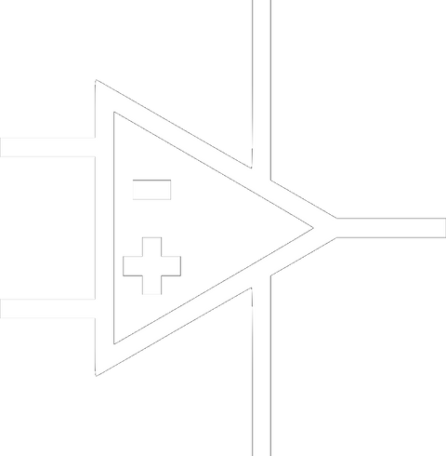
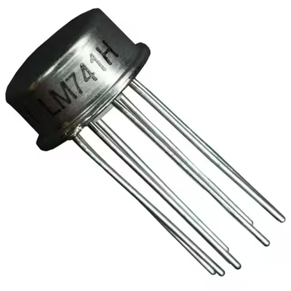
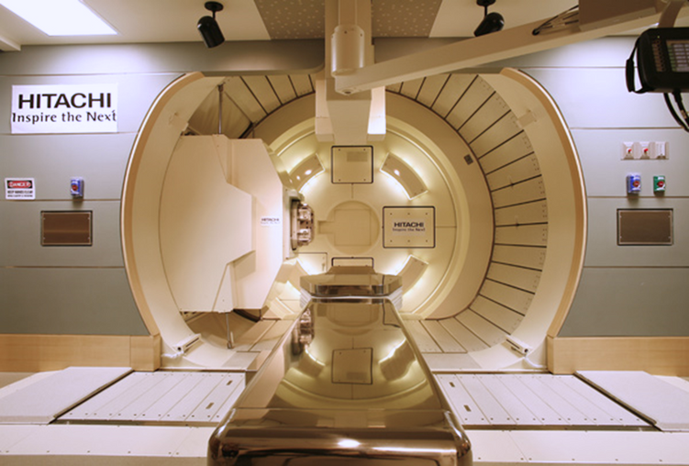

DEVELOPING A TEST INTERFACE
Selected DUT:
LM741 Operational Amplifier
  General purpose, commonly used as noninverting
  Overload protection on input and output
  No latch-up when range is exceeded
Radiation Source:
Hitachi ProBeat IV Synchotron-based pencil beam scanning system at Mayo Clinic, Phoenix, AZ

Slide 8
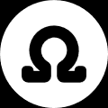

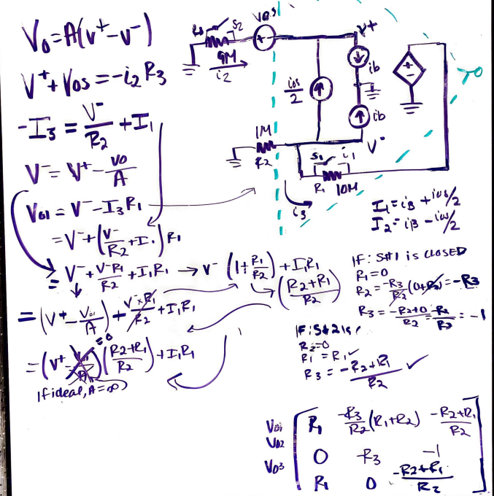
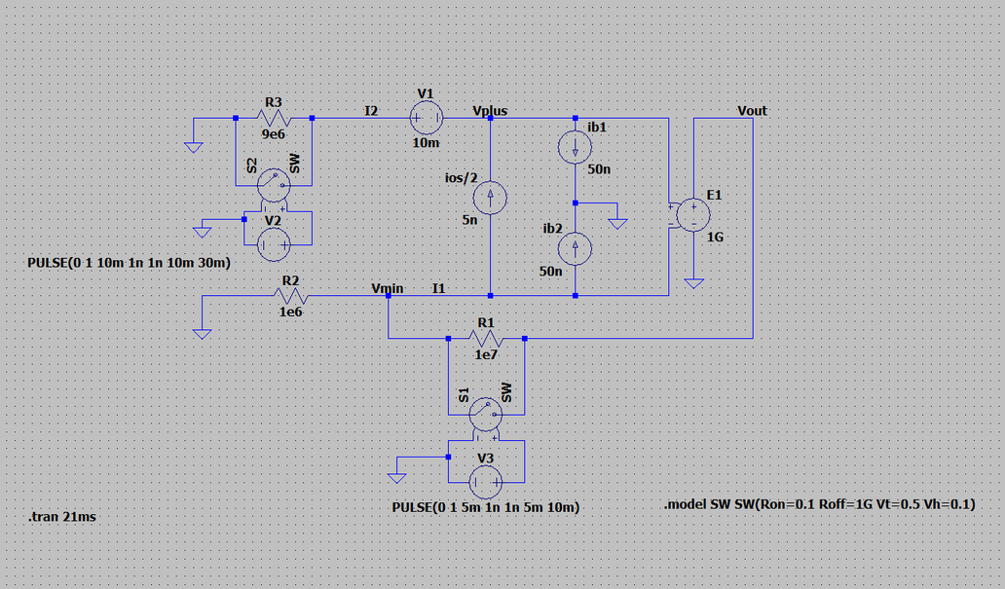
DEVELOPING A TEST INTERFACE, CONT.
Circuit Analysis
Simulation:
LTSpice

Slide 9


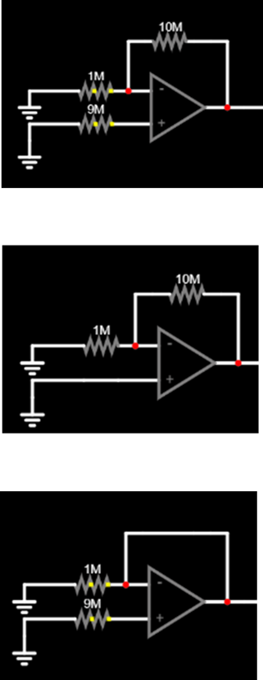
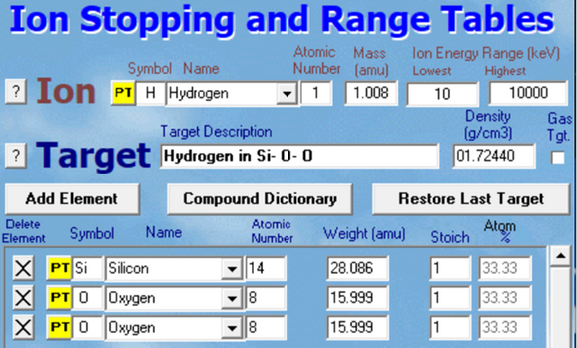
DEVELOPING A TEST INTERFACE, CONT.
Testing Parameters:
SRIM
Testing Configurations:
Arduino
Configuration #1 : (000)
Switch 1: LOW Exp. Output:
Switch 2: LOW -4.226 V
Switch 3: LOW
Linear Energy Transfer (LET): energy deposited per unit track length, normalized to density (MeV-cm2)
Total Ionizing Dose (TID): measure of energy absorbed by a unit mass per matter, or rad, by ionizing radiation.
Configuration #2 : (100)
Switch 1: HIGH Exp. Output:
Switch 2: LOW -0.425 V
Switch 3: LOW
September 2022
•200 MeV protons
•5mm beam diameter
•90% uniformity
•Measurement Points (Fluence) :
•Post 5 x 10^11 cm-2
•Post 2.5 x 10^12 cm-2
November 2022
•200 MeV protons
•5mm beam diameter
•90% uniformity
•Measurement Points (Fluence) :
•Post 1 x 10^12 cm-2
•Post 5 x 10^12 cm-2
Configuration #3 : (011)
Switch 1: LOW Exp. Output:
Switch 2: HIGH -0.570 V
Switch 3: HIGH

Slide 10

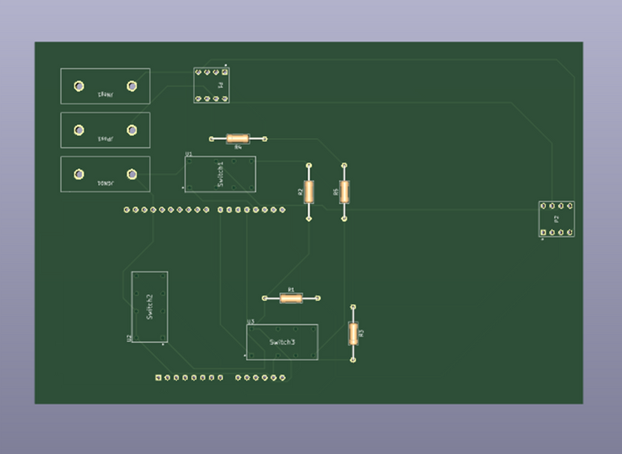
DEVELOPING A TEST INTERFACE, CONT.
PCB Design:
KiCad

Slide 11
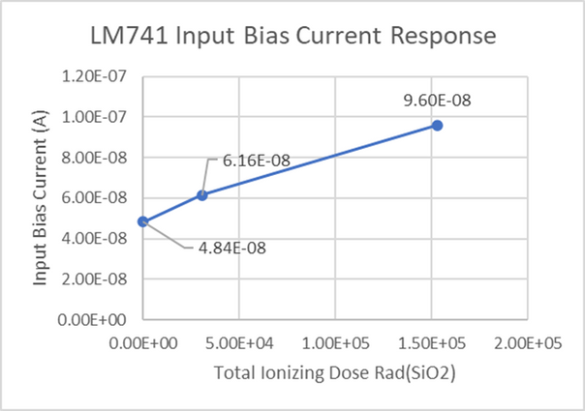
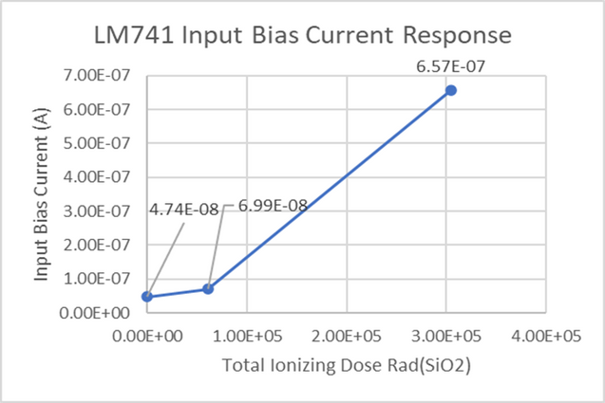
TEST RESULTS
SEPTEMBER RESULTS
  Consistent with long-term radiation Total Ionizing Dose (TID) effects
  Deleterious to device operation
NOVEMBER RESULTS

Slide 12
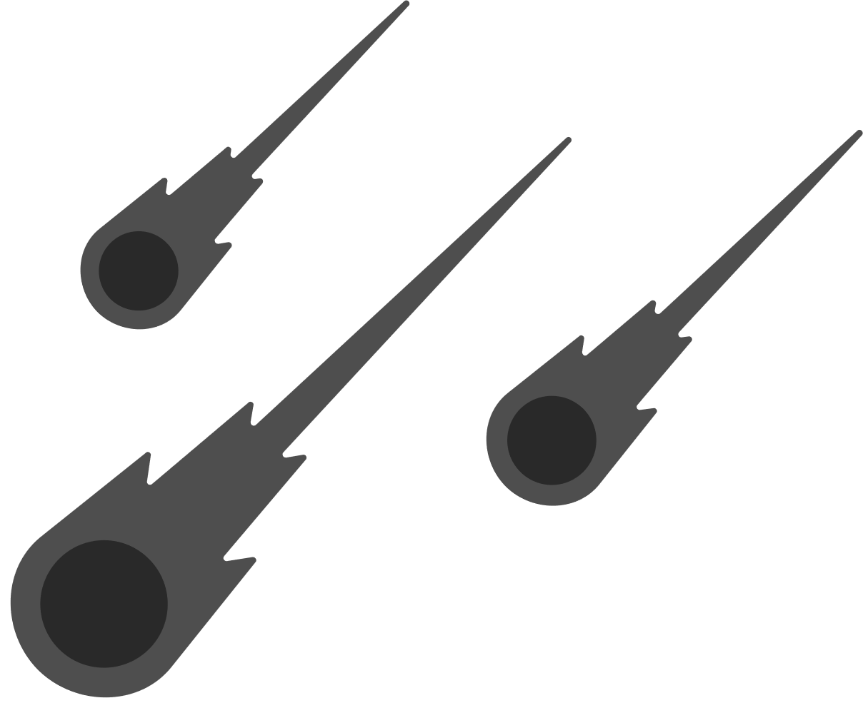

DATA INTERPRETATION
  Data shows damage prolonged radiation exposure can cause in LM741
  Changes in input bias current affect performance:
    Increased power consumption
    Inaccurate output readings
  Continued testing important for safety and reliability of space missions

Slide 13
VERSION 2
  Multi-DUT
    Linear Bipolar Circuits
    MOS
    Diodes
    FPGA
  More parameter data
    Slew Rate
    Temperature
    Voltage Range
  Multi-use

Slide 14
Questions?

Slide 15


Acknowledgments
A special thanks to :
  Dr. Hugh Barnaby, for the guidance and mentorship
  Dr. Daniel Robertson and the Radiation Oncology Research Committee at the Mayo Clinic for allowing and facilitating the use of proton beam for academic use
  ASU/NASA Space Grant Consortium

